Slide 1

ECEN 361
Real-Time and Embedded Systems
IOT – Internet of Things
Power

Slide 2
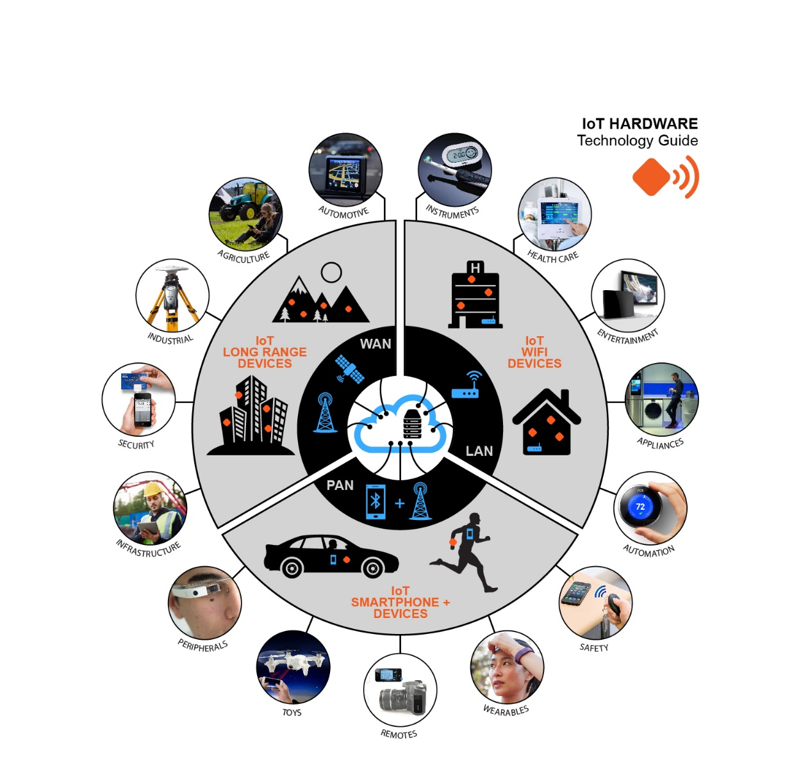
IOT
Internet of Things
Devices that are always available and always connected

Slide 3
IOT
Internet of Things
Devices that are always available and always connected
Power
Communications
Information

Slide 4
IOT
Internet of Things
Devices that are always available and always connected
Power
Communications
Information

Slide 5
IOT - Power
Power – Three Solutions
Standard Grid Power Available
Manufacturing
Home
Battery Power
Remote applications
Mobile Applications
Energy Harvesting
Really Remote Applications
Really Mobile Applications

Slide 6
IOT - Power
Power – Three Solutions
Standard Grid Power Available
Manufacturing
Home

Slide 7
IOT - Power
Power – Three Solutions
Standard Grid Power Available
Manufacturing
Home
Here the conversation is normally around Power quality
What happens when the power goes out?
What happens when the Voltage dips?

Slide 8
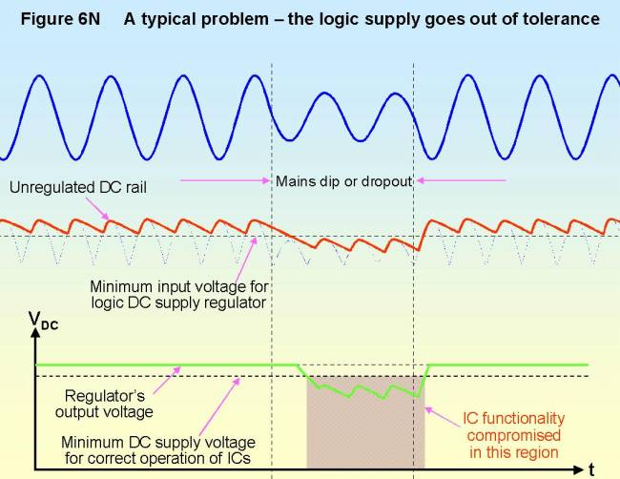
IOT - Power

Slide 9
IOT - Power
Power – Three Solutions
Battery Power
Remote applications
Mobile Applications
Here the conversation is normally around Power Storage and Usage
How big a battery and of what type?
What can we do to limit power usage?

Slide 10
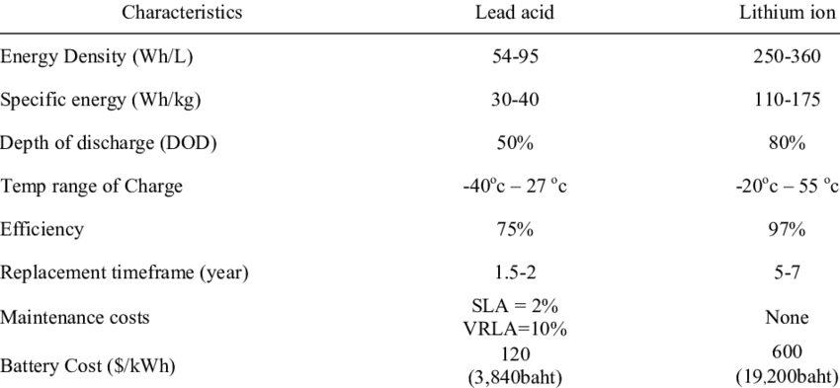
Battery Considerations

Slide 11
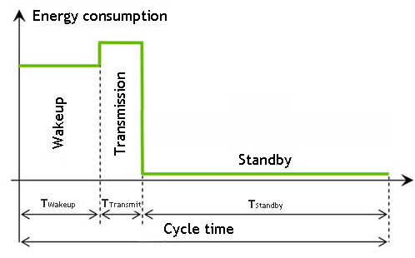
Power Management
Managing the power that you have

Slide 12
IOT - Power
Power – Three Solutions
Energy Harvesting
Really Remote Applications
Really Mobile Applications
The key conversation is around where the power comes from:
Natural Energy – Solar, Wind, Thermal
RF Energy – Transmitted
Energy generated by other means – movement.

Slide 13
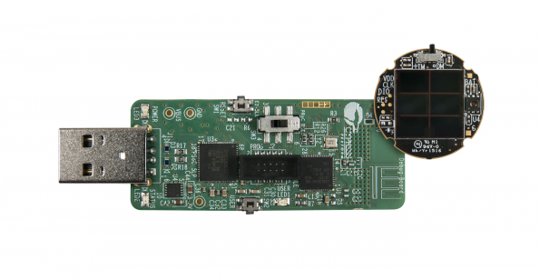
IOT - Power
What do we do when the sun doesn’t shine (or the wind doesn’t blow?)

Slide 14
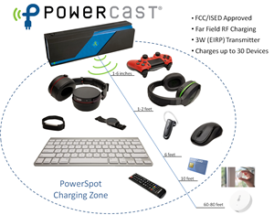
IOT - Power
Power at Distance Technologies

Slide 15
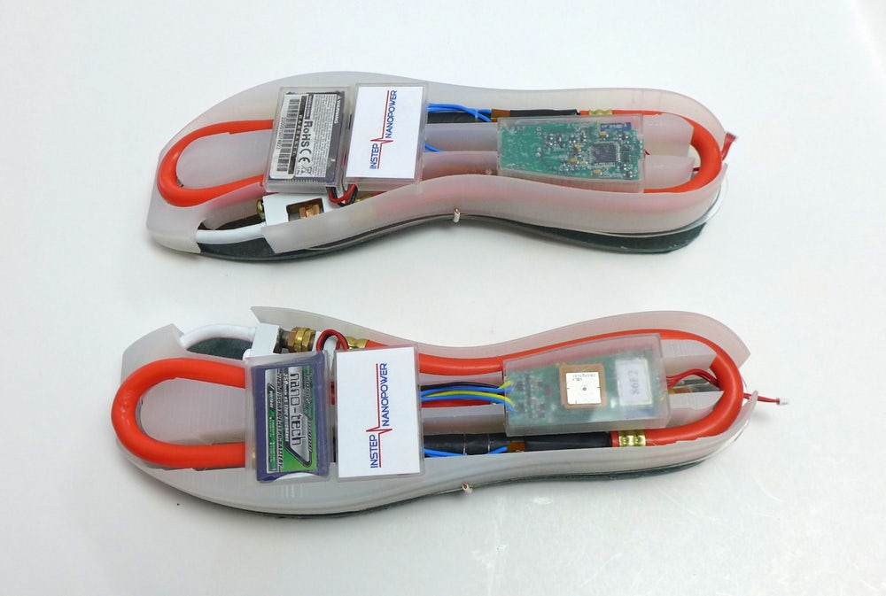
IOT - Power
Power at Distance Technologies

